Slide 1
ASP.NET Core Web API
acADDemICTs training

Slide 2
Agenda
.NET Core
.NET Standard
Fundamentals
HTTP verbs and responses
API Controllers
Filters
Security
Notes:
- .NET Core introduction
- .NET Standard to remove any confusion about these two new things in the .NET ecosystem
Fundamentals:
Application startup
Middleware
Routing basics
Configuration
DI
HTTP Verbs and responses
API Controllers
Filters:
Action filters
Result filters
Authorization filters
Exception filters
Security:
Enforcing SSL
Authorization
CORS

Slide 3
.NET Core
A reboot
Cross-platform
Open source
Granular
Side-by-side
Notes:
.NET Core is a true reboot of the .NET framework, so it has been written from scratch again, giving Microsoft the opportunity to incorporate a better design – something not possible in the full .NET Framework without potentially braking billions of applications out there.
Being a complete reboot, it has been designed with cross-platform in mind from day one. .NET was intended to be cross platform from the beginning, but technology like Windows Forms made it nigh impossible to fully port the .NET Framework (and applications) to other platforms like Linux or Mac OS, although Mono has done a remarkable job in this field.
With .NET Core however, Microsoft (and partners like Samsung and Qualcomm) has been focusing not only on the Windows platform, but also Linux, Mac OS and others (Android i.e.) from the start, delivering the possibility for developers to not only target these platforms, but also to write code using .NET Core on these platforms.
But contributing is not limited to Microsoft employees or partners, everyone can contribute to .NET Core or ASP.NET Core, EF Core, … This also means that its easier than ever to dive into the source code as an additional source of documentation.
Next to being a reboot of the framework and targeting multiple platforms from day one, .NET Core offers several offer major improvements. The full .NET Framework consists of the common object runtime library, a single DLL file on your system – mscorlib.dll –, and several additions installed in the global assembly cache. For (older) ASP.NET projects, which depended on System.Web, this means that you had a dependency on two assemblies totaling 10 MB by default.
With .NET Core, functionality has been reorganized into much smaller components and separate NuGet packages, which yields the benefit of having only to download (and deploy) the assemblies your code actually needs to run. Additionally, this allows us to deploy our application using very specific versions of both the .NET Core runtime and our dependencies side by side with other applications: you can choose to deploy and use the default installed version of the runtime, or deploy the runtime with your application and be independent.
This feature might not seem that important, because .NET Framework already supported side-by-side installations, but only to a certain degree: .NET 1.1, 2.0 and 4.x are side-by-side, but all future installs of, say v4.6.1, v4.6.2 and v4.7 do upgrade several components, meaning that they might have an effect on applications running on v4.0. This is not the case with .NET Core if you choose to deploy the runtime with your application.

Slide 4
.NET Standard
A Microsoft standard
Defines .NET API levels
Replaces PCL profiles
https://github.com/dotnet/standard/blob/master/docs/versions.md
Notes:
.NET Standard is a new Microsoft standard, defining a common set of API’s which needs to be implemented by platforms/frameworks per version of the standard. This should make it a lot easier for developers of libraries to target multiple platforms and framework versions, instead of having to deal with the obscurity in PCLs (Portable Class Libraries) like “portable-net45+win8+wpa81+wp8”

Slide 5
Fundamentals – Starting an ASP.NET application
Program.cs – The entrypoint
WebHost.CreateDefaultBuilder
Kestrel
UseIISIntegration
Notes:
Program.cs is the entry point of your ASP.NET Core application, just like a console application. In its most basic form, you only need to build a web host using your startup class and you’re good to go.
When we dive in to Visual Studio, you’ll see WebHost.CreateDefaultBuilder. This will suffice for most applications and will configure your ASP.NET application with the following:
It uses the new Kestrel web server
Sets the content root path to the current directory
Loads configuration from
appsettings.json and appsettings.[environment].json
User secrets from the current assembly when the environment is development
Settings from environment variables
Finally, settings provided using the command line
Enables both the console and debugger output logger
Enables IIS integration
Enables other frameworks (like EF Core) to bind their options to the configuration
Adds the default developer exception page when the environment is development
Now, Kestrel is a new web server, written to be used on Windows, Linux, MacOS, … platforms. You can use Kestrel as-is, but when you want to host multiple apps on Windows or Linux boxes, you will need to use IIS (on Windows) or another server like Nginx or Apache to function as a reverse proxy, directing requests for several domains or virtual directories to the correct Kestrel instance.
UseIISIntegration (which now is called by default in ASP.NET Core 2.0) hooks up the ASP.NET Core Module, which enables running Kestrel within IIS or IIS Express. Visual Studio installs this module for you on your machine, but when setting up a server, you might need to manually install this module. You can find it here: https://aka.ms/dotnetcore.2.0.0-windowshosting

Slide 6
Fundamentals – Starting an ASP.NET application
Startup.cs – The configuration
ConfigureServices (Optional)
Configure
Notes:
In Startup.cs, you will be adding your middleware (more on this subject in a few moments) and configure/enable it.
One kind of middleware you’ll encounter in most ASP.NET Core applications is MVC itself, which is used for both MVC and Web API projects.
The ConfigureServices method is optional, but when present, will be called before Configure. Which is only logical, because in ConfigureServices, you’re going to add or register the services used by your application, like authentication services, MVC itself, your own data services, and so on.
The Configure method configures the HTTP pipeline: imagine that every HTTP request to your ASP.NET Core application will pass through this method and will be transformed by the middleware that you add in this method. This means that the order of the middleware in the Configure method is very important: if you add app.UseAuthentication after app.UseMvc, your users will never be able to authenticate in your application because the MVC middleware acts first. Let’s have a more detailed look at this.

Slide 7
Fundamentals – ASP.NET Core 2.1
services.AddMvc().SetCompatibilityVersion(CompatibilityVersion.Version_2_1);
Configures the default MvcOptions for ASP.NET Core 2.1
Be careful with CompatibilityVersion.Latest
Notes:
When you create a new ASP.NET Core 2.1 web application, you’ll see a new line of code in ConfigureServices:
services.AddMvc().SetCompatibilityVersion(CompatibilityVersion.Version_2_1);
This method sets different defaults for MvcOptions based on the selected compatibility level. For some of the new features in ASP.NET Core 2.1, like the ApiControllerAttribute, you will need to use compatibility level 2.1 or higher. You could also use CompatibilityVersion.Latest, but this might introduce some weird new behaviors that don’t really work with your application, so I advise to not experiment with that enum value.

Slide 8
Fundamentals – HTTP Pipeline and middleware
HTTP request
Fall through middleware
HTTP response
Notes:
When your application receives an HTTP request, it will fall through the middleware as configured in the Configure method. If all goes as planned, the MVC middleware will respond to it and create an appropriate HTTP response. But suppose that something bad happened: an exception has been thrown.
MVC will throw the exception back into the HTTP pipeline, but another middleware will pick it back up (when the environment is Development, that is): the UseDeveloperExceptionPage() middleware. This one will wrap that exception into an informational page, allowing us to inspect what went wrong.

Slide 9
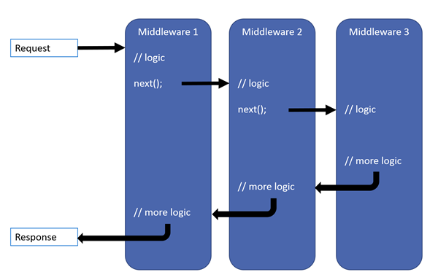
Fundamentals – HTTP Pipeline and middleware
Notes:
When your application receives an HTTP request, it will fall through the middleware as configured in the Configure method. If all goes as planned, the MVC middleware will respond to it and create an appropriate HTTP response. But suppose that something bad happened: an exception has been thrown.
MVC will throw the exception back into the HTTP pipeline, but another middleware will pick it back up (when the environment is Development, that is): the UseDeveloperExceptionPage() middleware. This one will wrap that exception into an informational page, allowing us to inspect what went wrong.
--------------
In Configure:
App.Use() to intercept before and after invoking the next one
App.Run() to return something
--------------
The order is important! If you place the UseDeveloperException middleware after the UseMvc one, it won’t be able to catch the exception and wrap it in a nice page because the error has happened already.

Slide 10
Fundamentals – Environments
Development, staging and production
UseDeveloperExceptionPage
Self-signed certificates
In-memory versus distributed cache
ConfigureDevelopmentServices, ConfigureStagingServices, …
And ConfigureDevelopment, ConfigureStaging, …
StartupDevelopment.cs, StartupStaging.cs, …
In conjunction with UseStartup (“your assembly name”)!
Notes:
I briefly mentioned the development environment a few times. When you’re working on an application, you will typically target multiple environments during the development process. The most common environments are development, staging and production.
Your application will, for the most part, work exactly the same in these environments, but there might be some significant differences. During development, you will typically not use an expensive wildcard SSL certificate or use a distributed cache system, but on production you will.
How can you easily create a single application but still be able to cater all these needs? Well, you have at least two options to do this:
Provide separate ConfigureServices methods for each environment
Or provide separate Startup classes when things get too messy to handle in separate methods alone. But you’ll need to use another way to load your Startup then in the bootstrapper.

Slide 11
Fundamentals – Routing
Map URL’s to controller classes and action methods
In Web API, the HTTP verb is the action
GET => GetSomething
POST => CreateSomething
PUT => ReplaceSomething or UpdateSomething
PATCH => UpdateSomething (partially)
DELETE => RemoveSomething
Notes:
The routing engine of ASP.NET allows us to easily map URLs to controller classes and action methods within. For Web API, our controllers typically represent our resources (like customers) and the actions are HTTP verbs

Slide 12
Fundamentals – Routing
[Route(“api/[controller]”)]
[HttpGet]
[HttpGet(“{id}”, Name = “GetById”)]
[HttpPost]
[HttpPut]
[HttpPatch]
[HttpDelete]
Notes:
To define the prefix for all action methods in a single controller, you can add a RouteAttribute as shown here on the slide. You can also replace [controller] with something more concrete to override this.
Decorate your action methods with the correct verb attribute, optionally including a template and a name and/or order.

Slide 13
Fundamentals – Routing constraints
{id:int}
int, long, bool, float, double, decimal, guid, datetime
alpha to only allow characters from a to z (case insensitive)
minlength(x), maxlength(x), length(x) or length(min, max)
min(x), max(x), range(min, max)
regex(expression)

Slide 14
Fundamentals – Configuration
JSON is a first-class citizen
Default:
appsettings.json
Environment specific JSON
Environment variables
Command line variables
Notes:
Unlike in all previous ASP.NET versions, JSON is now (finally) a first-class citizen when configuring your application. No more dealing with the dreaded web.config XML file, unless you really want or need to.
By default, your application has been configured to go through the generic appsettings.json file first, quickly followed by appsettings.environment.json if it exists. Any configuration present in the latter will overrule the original settings.
The same deal applies to environment and command line variables, so you can always overrule settings at the last minute by providing a value for them in your machine settings or at the command prompt, should you start your web app manually.

Slide 15
Fundamentals – Configuration
Secrets
Like database passwords
Or certificate keys
NuGet credentials for publishing packages
…
User secrets!
Notes:
If you’re developing against a SQL database, but can’t run the database on your machine, you might end up configuring a connection string with a username and password combination. If the codebase is on premise, that might all be just fine.
But what if you’re creating NuGet packages and pushing to a public repository on Github? You don’t want just anyone to be able to use your credentials to push a new version of that package!
In ASP.NET Core, you can use the secret manager to configure secrets per user. The resulting file will live outside of your project, so yes, every developer will need to repeat this process, but it will also help to prevent these secrets from leaking to the outside world.
And when deploying to a production server (or to Azure), you can overrule the secret settings using environment variables. Easy peasy.

Slide 16
Fundamentals – Configuration
Custom options?
Just create a POCO
And adjust ConfigureServices
.AddOptions()
.Configure<MyOptions>(Configuration);
Injectable in your controller: IOptions<MyOptions> or IOptionsSnapshot<MyOptions>
Notes:
Providing custom option classes has never been easier. Previously, extending the XML configuration needed a lot of custom work, in order to properly (de)serialize that XML to an instance and vice-versa.
Now, it is as easy as creating a simple POCO class, containing public properties for the options you need configured.
In ConfigureServices, you need to add the AddOptions method to load the service, and can then add your custom option classes, optionally pointing to a subsection of the configuration.
Inside controllers, you inject your options using an accessor interface.

Slide 17
Fundamentals – Dependency Injection
AddSingleton
AddScoped
AddTransient
Replaceable
Notes:
ASP.NET Core comes with built-in dependency injection. As previously mentioned, you can inject your custom options into controllers, by using constructor injection.
Inside ConfigureServices, you can register your own services by using three methods. AddSingleton registers a single instance for the entire application, AddScoped registers an instance per HTTP request and AddTransient will give you an instance per resolve request (each time you want this service somewhere, you get a fresh instance).
For demo to medium-sized applications, this will get you going far enough. But know that you can extend the DI capabilities by replacing the standard container with a third-party one, like Autofac. Autofac allows finer control over services and supports more advanced concepts like decorators.

Slide 18
HTTP Verbs and Responses
GET
200 OK
404 Not Found
403 Forbidden
POST
201 Created
400 Bad request
403 Forbidden
Notes:
When building a Web API, you can create an api like people used to when talking about SOAP or WCF services, which have endpoints resembling operations or methods. But Web API’s nowadays tend more to be RESTful API’s, which talks about resources and ways to interact with these resources. In this course, we will not dive into the details of RESTful services, we will only touch the surface by explaining the 5 most used HTTP verbs and the typical HTTP status code you can expect to get back.
GET requests are used to retrieve a list of resource items, or a single item when identified by its ID. When retrieving a list, you typically return 200 OK upon success (containing an empty list if there is nothing to return) or 403 Forbidden if the user doesn’t have access to this resource. When retrieving a single item, another response might appear: 404 Not Found, returned when there is no resource matching the given ID.
Creating resources is typically done using the POST verb on /resources and, when successful, yields a 201 Created response, optionally providing a location header where the resource can be located. When you start a lengthy operation (like, for example, spinning up a new virtual machine instance), you don’t have to return 201 because that status code means that all the work has completed. Instead, return 202 Accepted to indicate that the request was fine, but will take some time to complete.
If the request contains one or more errors, you can return 400 Bad Request and indicate what the consumer of the API should alter in order to make a good request instead.

Slide 19
HTTP Verbs and Responses
PUT
200 OK
201 Created
400 Bad Request
404 Not Found
403 Forbidden
DELETE
204 No Content
404 Not Found
403 Forbidden
Notes:
PUT is a little bit special. This verb is used to either create, replace or fully update a resource item. Creation, however, is only possible when the user can dictate which ID to use, because a PUT request is targeted to a single resource.
When creating, 201 Created is expected, when updating/replacing, 200 OK. If creation is not possible, a 404 should be returned if the ID does not exist. 400 and 403 remain the same.
DELETE removes a resource and returns 204 No Content (although some people just return 200 OK) when the delete is successful. Again, if the resource is not found (which should be the case after a successful DELETE request), 404 should be returned.

Slide 20
HTTP Verbs and Responses
GET /parents/{parentId}/children
200 OK
204 No Content
404 Not Found
403 Forbidden
Notes:
When dealing with child resources, things change a little (although, again, some mileage may vary). Look at the URI for the GET request: when /parents/{parentId} does not exist, you’d return a 404, so when you try to retrieve its children, you would do the same, right? Right! But what should you return when the parent resource does exist but doesn’t have any children yet? I’m a fan of returning 204 in that case, while others prefer 200 OK and an empty list. My advice: choose one of these approaches, but stick with it throughout the API for consistency.

Slide 21
API Controllers
Convention: a class ending with “Controller”
Or any class, marked with a [Controller] attribute
Can inherit from ControllerBase for convenience
Responds to routes using public methods
Notes:
In ASP.NET Core, a controller will act as the main entry point for HTTP requests. To create a controller class, you have several options available:
Either create a public class with a name ending in “Controller”
Or create a public class marked with the [Controller] attribute
Or create a public class which inherits ControllerBase
The last option is the most commonly used one, because ControllerBase already contains some handy properties and methods which you will be using a lot when responding to HTTP requests.
Let’s write our first API controller. (create class, inject repo/service, write get/getbyid/create/delete methods)

Slide 22
API Controllers
[ApiController]
Needs compatibility level 2.1
Auto validates model state and returns 400 results
Automatic binding of values
Form data defaults to multipart/form-data
Needs attribute routing for this to work!
Notes:
Especially when dealing with rather simple API controllers, you’ll quickly see a pattern repeating itself. To simplify the amount of work, we can also make use of a new feature in ASP.NET Core 2.1, using the [ApiController] attribute. By default, this will apply the following behavior:
Automatic validation of the ModelState and returning 400 Bad Request when the state is invalid
Automatic binding of parameter values from the body, query, header, … Complex types will typically automatically look to bind from the request body, while simple types will be matched from a query value instead (or a route value if the name matches).
The last behavior is a bit more technical: when you have data coming from a form (using FromForm or via specific types like IFormCollection or IFormFile), then ASP.NET Core will assume that the request contains multipart/form-data
These behaviors can be disabled by configuring the ApiBehaviorOptions in ConfigureServices:
services.Configure<ApiBehaviorOptions>(x => {});

Slide 23
API Controllers
Disable features using ApiBehaviorOptions
ModelStateInvalidFilter
ApiBehaviorOptions.InvalidModelStateResponseFactory
Notes:
These behaviors can be disabled by configuring the ApiBehaviorOptions in ConfigureServices:
services.Configure<ApiBehaviorOptions>(x => {});
For the first feature, that automatically validates ModelState, ASP.NET Core is actually just autoregistering a new filter: ModelStateInvalidFilter. This filter is added to all calls where ApiController is being applied to, and internally, the order is so low (-2000) that it will be executed as one of the first filters after model binding has been executed.
You can change its behavior to return a custom result or change the status code from 400 to something else if you want, again by configuring the ApiBehaviorOptions. But this must be done *AFTER* the SetCompatibilityVersion call!

Slide 24
API Controllers
IActionResult
ActionResult<T>
IActionResult + [ProducesResponseType(200, Type = typeof(Customer))]
ActionResult<Customer> + [ProducesResponseType(200)]
Notes:
We haven’t really spoken about the return values yet. While you could return the actual type, like Customer or List<Product>, it’s usually a better idea to use more generic types, because these allow you to also easily return 404 Not Found, 201 Created and so forth.
The first, most basic return type, is the interface IActionResult or Task<IActionResult> when creating asynchronous controllers.
The second one is ActionResult<T> or Task<ActionResult<T>>, which allows you to be more verbose in the expected return type, while still allowing to return other ActionResult types, like NotFoundResult for example, using the same code as you would when using IActionResult.
The main difference is when adding [ProducesResponseType] attributes when generating API documentation: for typed responses, you’d have to specify the type as well. Using ActionResult<T> removes this need.

Slide 25
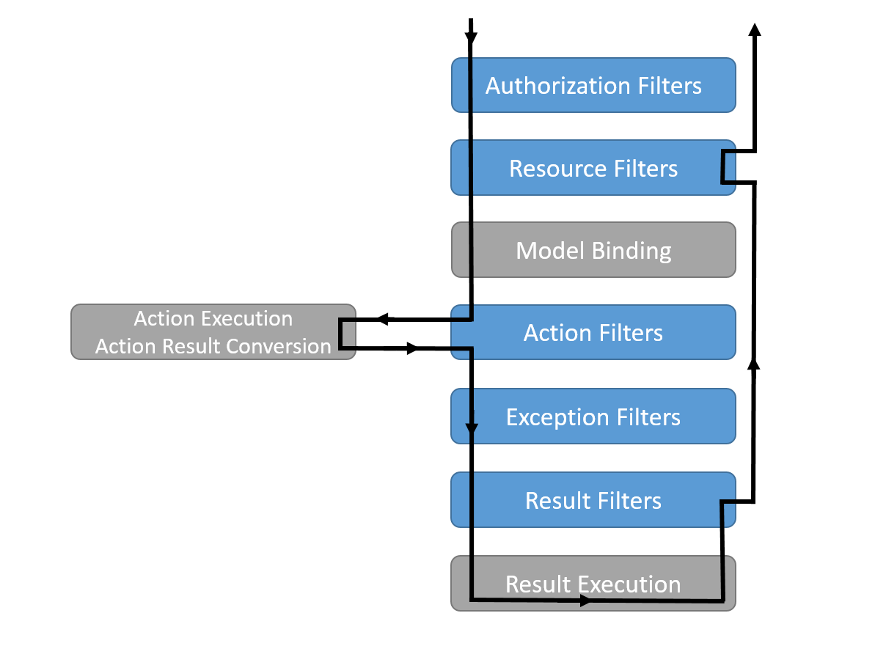
Filters
Notes:
Filters are attributes that allow you to run code before or after certain stages in the HTTP request pipeline, and are useful to handle cross-cutting concerns in your application, like handling specific exceptions or dealing with unauthorized users.
When the MVC middleware receives a request, and finally selects which controller method to execute, that’s when filters might come in to play.
First in line are authorization filters, used to determine if the current user, if any, is authorized to perform the current request.
Next come resource filters, which have two specific uses:
When entering in the request, they can alter the body of the request to simplify the model binding (like merging hour and time fields into a TimeSpan). Or they can recognize the request and choose to feed a response immediately from a cache.
When exiting the request (and forming the response), they might add the response to a cache.
Action filters run right before and after executing a controller method, and can be used to perform some last minute switches of the input and output arguments. I’ve used this in projects to deal with paging requests, pulling paging data from a header and putting it back there when returning.
Exception filters are used to catch global, unhandled exceptions and to transform them in user-friendly JSON objects (in API’s at least) or to log them.
Result filters are the last ones in the row, and are run before and after executing the result, which is only used in views or when running formatters (transforming your objects into JSON or XML).

Slide 26
Filters
Add an attribute to a controller
Or a method
Or register globally using options.Filters.Add()
FromQuery, FromBody, …

Slide 27
Security
Enforcing SSL (or HTTPS)
RequireHttpsAttribute
Use rewriter to transform all HTTP requests into HTTPS
Notes:
Let’s talk a bit about securing our Web API. First of all, we prefer to host all web content over HTTPS nowadays, so we should immediately register a global RequireHttpsAttribute filter. But we can do better, by rewriting all HTTP requests to HTTPS. In order to do this, we need the Microsoft.AspNetCore.Rewrite package and need to configure a rewrite rule:
Configure() {
var options = new RewriteOptions().AddRedirectToHttps();
app.UseRewriter(options);
}

Slide 28
Security
Enforcing SSL (or HTTPS)
RequireHttpsAttribute
Use rewriter to transform all HTTP requests into HTTPS
New! app.UseHttpsRedirection()
dotnet dev-certs https
Notes:
Luckily for us, in ASP.NET Core 2.1 it has become a lot easier to make HTTPS a first-class citizen, as it should be really. Now, we can call app.UseHttpsRedirection in the Configure method to redirect our uses to the secured endpoint. In ConfigureServices, you can configure the redirection to use a specific port if necessary (or set the HTTPS_PORT environment variable).
At the command line, you can now also easily generate a development SSL certificate and optionally trust that certificate (using dotnet dev-certs https --trust).

Slide 29
Security
AuthorizeAttribute
User object
Web API? Token-based
Notes:
To enforce users being logged on, you can use the AuthorizeAttribute. Inside an action method, you can also access the User object and inspect its roles (or claims) to see if he/she has sufficient access. If not, you can return a forbidden response.
Now, to secure a Web API, the current recommendation is to use token-based security. However, that subject is another course entirely.

Slide 30
Security
CORS (Cross origin resource sharing)
When accessing an API from an untrusted source (javascript clients) and from another domain
Microsoft.AspNetCore.Cors
services.AddCors()
app.UseCors(builder => builder.WithOrigins(“http://myclient.com”));
[EnableCors]
[DisableCors]
…
Notes:
When you build an Angular client for your Web API, you will soon find that you’ll hit issues. And they will probably be related to CORS, because your API lives on a different host (or port) than your client application.
Whenever the Angular app tries to access an API living on a different domain, the browser first sends an OPTIONS verb to that API URL, to see if it can perform the GET or POST… request that you would like to perform. If the API allows it, it will respond with an Access-Control-Allow-Origin header.
To enable CORS, there is another nuget package to add and to configure. You can configure this globally using policies (services.AddCors(options => options.addpolicy)) and then enable these policies (app.UseCors(“policyname”)) or just build policies when calling UseCors.
Another method is to add EnableCors attributes on controllers or action methods, DisableCors to disable CORS for an action or add it globally to the options.Filters using CorsAuthorizationFilterFactory

Slide 31
Security
HSTS
HTTP Strict Transport Security
Promises browser that you’ll always support HTTPS
Preload: https://hstspreload.org/
Notes:
Also new in ASP.NET Core 2.1, is that a new project will also include a line to app.UseHsts in the Configure method. Again, this is configurable in ConfigureServices, and allows you to inform web browsers that your web application will always be available using HTTPS.
This allows browsers to, once they know your website and that you support HSTS, internally redirect to HTTPS if someone tries to navigate to HTTP instead. While this doesn’t seem that important, it is when some public WiFi hotspots (like in hotels) might get hacked and replace your website contents, which they can only do without you noticing when the site is being served over HTTP.
And you can go the extra step as well, by listing your web application on hstspreload.org: when you register your site, a future update of Chrome, Edge, … will include this updated list and immediately redirect users to HTTPS://yoursite.com, even if they’ve never visited your site before.

